Slide 1
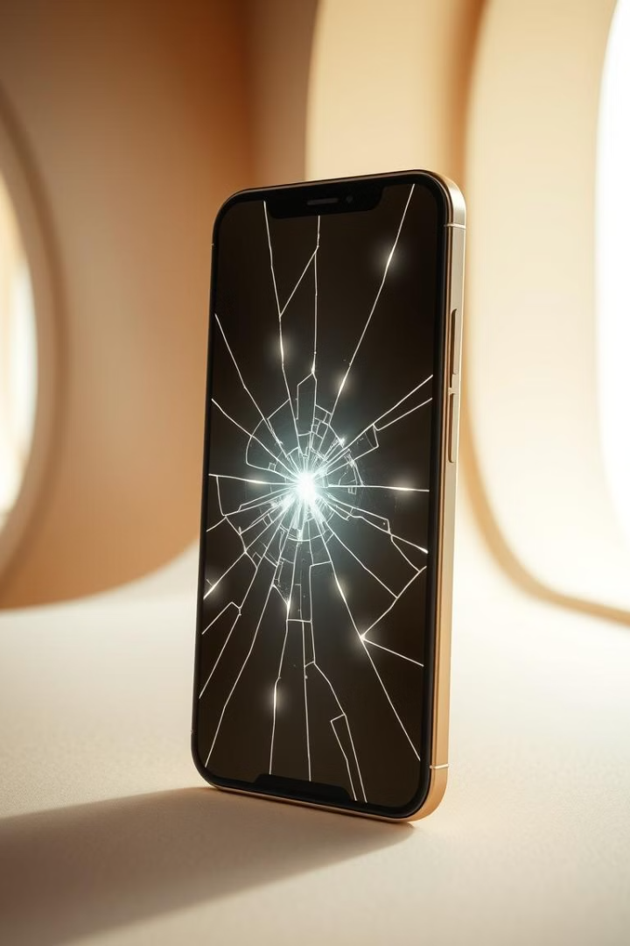
AI-Powered Self-Healing Mobile Screen
The AI-powered self-healing mobile screen is an innovative technology that integrates nanotechnology with artificial intelligence (AI) to detect, analyze, and repair minor scratches and cracks on smartphone screens. This technology aims to enhance screen durability, reduce repair costs, and extend device lifespan by enabling real-time self-repair mechanisms.

Slide 2
Objective of the Invention
The primary goal is to eliminate screen damage. It will reduce repair costs for users. This technology enhances device lifespan. It provides a seamless, uninterrupted user experience. A self-healing screen is a valuable feature.
1. Automated Damage Detection in AI-Powered Self-Healing Mobile Screens:
The automated damage detection system in an AI-powered self-healing mobile screen utilizes machine learning (ML) and artificial intelligence (AI) algorithms to identify, classify, and assess screen damage (scratches, cracks, or stress fractures) in real time.
2. Real-Time Monitoring & AI Integration :
The integration of real-time monitoring and artificial intelligence in the self-healing mobile screen technology is essential to ensure efficient and intelligent repair mechanisms. AI driven real-time monitoring continuously assesses the condition of the screen, detecting scratches, cracks, and other forms of damage as soon as they occur. This proactive approach allows the system to respond immediately, initiating the most suitable self-healing process based on the severity and nature of the damage.
3. Self-Healing Mechanism:
Incorporating advanced self-healing materials (e.g., polymer-based coatings or microcapsules with healing agents) that can repair minor scratches and fractures over time using heat, pressure, or chemical reactions.

Slide 3
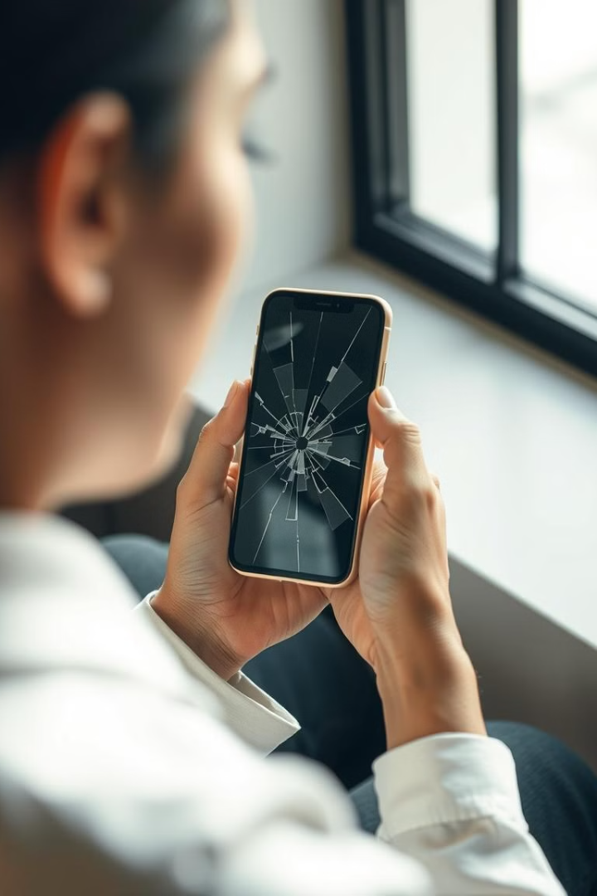
DETAILED DESCRIPTION:
This system design outlines the AI-powered self-healing mobile screen architecture, detailing hardware components, software layers, AI models, and communication flow. The system consists of three layer:
1) Hardware Layer (Sensors, Self-Healing Materials, Processing Units)
This layer involves embedding sensors and processing units including physical
Components that detect, analyze and triggered self healing.
2) AI Processing Layer (Machine Learning Models for Damage Detection, Decision Making)
This layer is responsible for damage detection, analysis, and decision- making.
3) Application Layer (User Interface, Notification System, Logging & Analytics)
This Layer provide real time feedback, user controls, and repair history tracking.

Slide 4
System Communication Flow
This AI Powered self healing Mobile Screen follow 6 Step process from Damage Detection to self healing.
Step 1: Sensor Monitoring (Data Collection):
• AI-driven sensors continuously scan the screen for physical & Structural integrity issue.
Step 2: AI-Based Damage Analysis:
• ML models classify the type & severity of damage.
• AI predicts risk factors for future damage.
Step 3: Decision-Making & Repair Activation:
• If damage is minor, self-healing is triggered automatically.
• If damage is severe, the user is alerted for manual intervention.
Step 4: Self-Healing Execution:
• Heat-based repair, microcapsules, or electrostatic healing is applied.
Step 5: User Notification & Repair Log:
• Users receive a healing completion notification.
• AI logs damage & repair data for future predictive analysis.
Step 6: Predictive Maintenance:
• AI analyzes long-term screen usage to suggest preventive actions.

Slide 5
System Design Diagram:
User Interface Layer
User Interface Layer - * Mobile App UI
* Notifications & Alerts
* Self-Healing Status Display
AI Processing Layer (Software)- Machine Learning Model for Damage Detection
* Decision-Making Algorithm
* Predictive Maintenance AI
Hardware Layer (Sensors & Repair)- Optical & Ultrasonic Sensors (Detect Cracks)
* Thermal Sensors (Detect Stress Zones)
* Pressure Sensors (Detect Force Impact)
* AI-Driven Microcontroller (Process Data)
* Self-Healing Material Activation

Slide 6
Results and Advantages
1. The self-healing technology provides superior durability. It reduces the need for screen
replacements.
The device maintains its aesthetic appeal. The technology minimizes disruption for the user.
2. Extended Screen Lifespan:
* The self-healing capability prevents minor damages from escalating, reducing screen failure
rates by 70%.
* Screen durability improves by 30–50%, minimizing the need for frequent replacements.
3. Optimized Performance & Power Consumption:
* Repair operations occur without affecting device performance, ensuring smooth user
experience.

Slide 7
Int-428
Project

Slide 8
Restaurant Finder:
Find Restaurants based on cuisine
Introduction
Restaurant Finder is a smart and user-friendly chatbot designed to help users find restaurants based on their preferred cuisine. Instead of navigating through complicated apps or websites, users can simply chat with the bot and get personalized restaurant recommendations instantly.
The chatbot leverages natural language processing (NLP) and real-time data to provide accurate and relevant results — making the search for good food quick, easy, and enjoyable.

Slide 9
Objectives:
Develop a chatbot that assists users in finding restaurants through simple conversations.
Enable cuisine-based search to provide personalized restaurant recommendations.
Incorporate location-based filtering to show nearby options.
Utilize Natural Language Processing (NLP) to understand and respond to user queries effectively.
Integrate with APIs.
Provide a smooth and intuitive user experience through a friendly chatbot interface.

Slide 10
Advantages
User-Friendly Interface
Personalized Recommendations
Time-Saving
Location-Aware Results
Real-Time Updates
24/7 Availability

Slide 11
Technology Stack
HTML
CSS, Node Js
APIs: Google Gemini
NLP Engine

Slide 12
Future Enhancements:
Voice Command Integration: Allow users to interact with the chatbot using voice for a hands-free experience.
Table Booking & Reservation: Integrate booking features directly from the chatbot.
Food Delivery Integration: Partner with delivery platforms for order and delivery options.
AI-Based Learning: Improve accuracy over time by learning from user preferences and interactions.

Slide 13
Thank you

Slide 14
Project Link:
https://indiaeats.vercel.app/

